Slide 1
Lecture 6

Slide 2
Δm

Slide 3
End

Slide 4
Question 223.4.5.1
If the index of refraction is n = 2, how fast is the light going in the material medium?
Twice the speed of light
Half the speed of light
A quarter the speed of light
1/16 the speed of light

Slide 5
Question 223.4.5 123.22.1
A 60W light bulb is allowed to burn for 3600s. How much energy has been used?
36000J
72000J
144000J
216000J
5400000J

Slide 6
Question 223.4.6 123.22.2
Suppose I do 50J of work in two hours, then I do 50J of work in one hour. For which set of work was the power larger?
The first
The second
They are the same
Neither amount of work had power associated with it.

Slide 7
Question 223.4.8 123.22.4
If you cup your hand to your ear, you can hear better. This is because
You change the frequency of the sound with your hand
You increase the collection area
You increase the amplitude of the wave
Can’t tell

Slide 8
For which professor is the sound louder?
Point Source
Professor A
Professor B

Slide 9
Intensity
r
Point Source

Slide 10
For which professor is the sound louder?
Point Source
Professor A
Professor B

Slide 11
Question 223.4.7 123.22.3
Tuning Fork: Which tuning fork is louder, the
mounted one
free one

Slide 12
Intensity in W/m²
Distance in meters

Slide 13
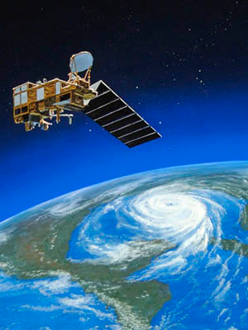
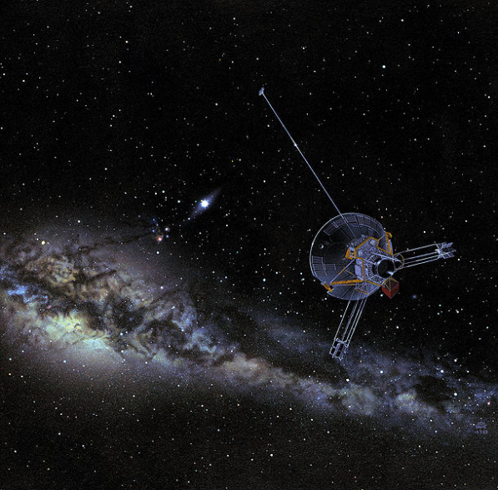
Question 223.4.9
The Pioneer 10 spacecraft has a large dish antenna, the Earth Observation System spacecraft has a much smaller antenna. Why?
Pioneer 10 is really smaller, it just looks like it is big in the picture.
The intensity of the communication signal goes down with the square of the distance. Pioneer 10 must be designed to work farther away.
The EOS satellite probably does not need to communicate as much as the Pioneer 10 spacecraft.
The Pioneer 10 spacecraft must have a wimpy transceiver.
No good reason, they have artists design the look of these things so they look far out and cool

Slide 14
Question 223.4.10 123.22.5
I have 100W of power coming from my speaker. What is the intensity 0.5m from the speaker?
a) 0.01W
b) Just under 1W
c) A little over 10W
d) A little over 30W

Slide 15
Intensity
1m
2m
3m
30m
20m
10m

Slide 16
Question 223.4.11 123.22.7
Suppose I have a loud speaker and 1m away from that loud speaker I measure an intensity of 1W /m². What is the sound level?
a) 3dB
b) 10dB
c) 120dB
d) 150dB

Slide 18
Question 223.4.12 123.22.8
Suppose I have a loud speaker and 10m away from that loud speaker I measure an intensity of 0.01 W /m². What is the sound level?
a) 30dB
b) 100dB
c) 120dB
d) 150dB

Slide 19
Question 223.4.13 123.22.9
Suppose I have two French horn players both playing the same note at the same time. I stand a meter away and find that they are each playing with an intensity of 0.00001 W/m². What is the sound level?
a) 0.00001
b) 70dB
c) 73dB
d) 1400dB

Slide 20
Question 223.4.14 123.22.10
You are sitting in church. The speaker is talking into a microphone. The sound system radiates sound with a power of 50W . You are 20m from the sound system output. What is the sound level?
a) 78dB
b) 80dB
c) 100dB
d) 120dB

Slide 21
Question 223.4.15 GR 123.22.11 GR
You are standing outside a Guns & Roses Concert. The concert is in a stadium. You are 40 m from the stadium. You have a sound level meter with you and find that where you stand the sound level is 120dB. How much acoustic power are the “musicians” creating at their output location?
a) 78W
b) 134W
c) 545W
d) 20106W

Slide 22
Question 223.4.16 123.22.12
You are sitting in church. The speaker is talking into a microphone. The sound system radiates sound with a power of 100W . You are 10m from the sound system output. What is the sound level? We can find this using our new SIL equation that includes power and distance.
a)50dB
b) 78dB
c) 109dB
d) 140dB

Slide 23
Question 223.5.1 123.22.13
You are a parent standing at platform 9.75. The Hogwarts Express is just leaving the station. The whistle blows. The engineer (if there is one) hears a perfect middle C (256 Hz). What do you hear as the train leaves?
A higher pitch than 256 Hz
A lower pitch than 256 Hz
Middle C (256 Hz)
Nothing

Slide 24
Inertial Frames
Remember Inertial Reference Frames
The two observers can both take the view that they are stationary
Newton’s laws are all good in either frame
y
v_{x}
A
B
x

Slide 25
Spherical Emitter Setup
Spherical Wave Crests
Detector
Point Source

Slide 26
Moving Detector

Slide 27
Moving Detector

Slide 28
Question 223.5.2 Question 123.22.14
A train passes you while blowing its whistle. Describe the frequency change
The change is nearly instantaneous
The change is gradual, as the train approaches the frequency changes proportionately with the distance from you
The change is gradual, as the train approaches the frequency changes inverse proportionately with the distance from you
Can’t tell

Slide 29
Question 223.5.3 Question 123.22.15
You are sitting on the Hogwarts Express. It is just leaving the station. The whistle blows. The engineer (if there is one) hears a perfect middle C (256 Hz). What do you hear as the train leaves?
A higher pitch than 256 Hz
A lower pitch than 256 Hz
Middle C (256 Hz)
Nothing

Slide 30
Question 225.5.4
Often a single jet will create two sonic booms, why?
One is from the plane and one is from the condensation trail that follows the plane
The nose and the tail both act as wave sources
One is from the plane and one is a Newton's third law reaction

Slide 31
Question 223.5.4.1
You are playing your Irish tin whistle at 440Hz. Your friend runs toward you at 10m/s. What frequency does your friend hear? (take 343m.s as the speed of sound)
453.8Hz
427.1Hz
453.2
427.5

Slide 32
Question 223.5.5 Question 123.22.16
A
B
C

Slide 33
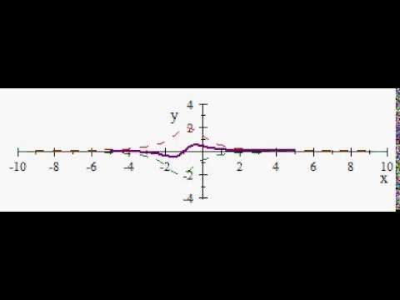

Slide 34
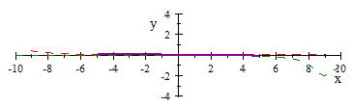

Slide 35
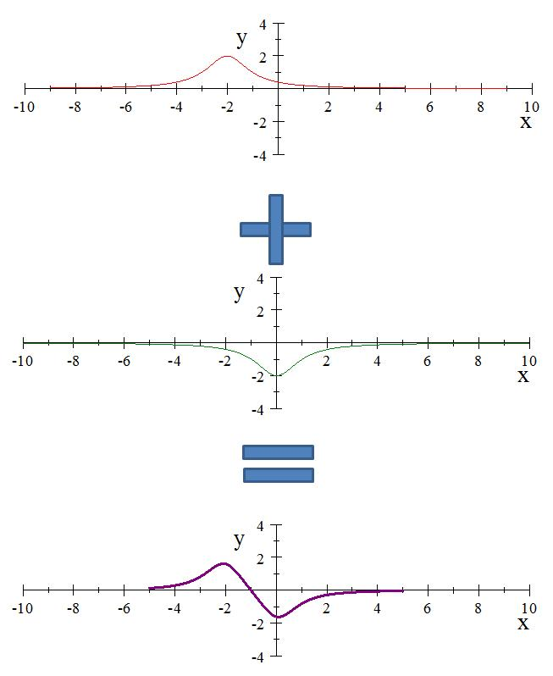

Slide 36
Question 11.3
A
B
C

Slide 37
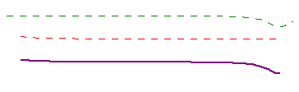

Slide 38
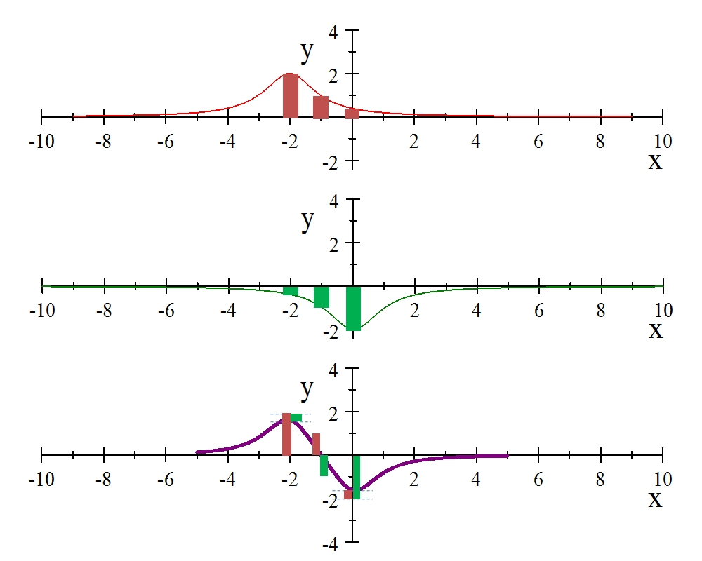

Slide 39
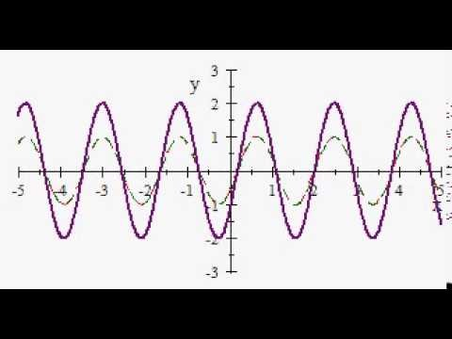

Slide 40
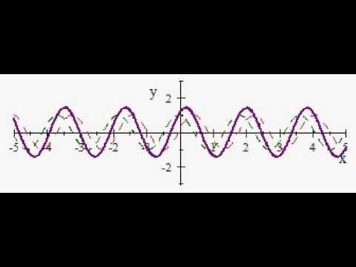

Slide 41
Question 223.5.6
Two pulses travel along a string in opposite directions. One pulse is inverted. When they meet, the string looks flat. Something must have canceled out. What is it?
Wave velocities
Segment velocities
Energy of the waves
Power of the waves

Slide 42
Question 223.5.7
I add two sinusoidal waves on a string and the two waves have the same amplitude and frequency, but are going the opposite direction. If the phase difference is equal to a half a wavelength, what do I get?
Twice the amplitude of the original waves
Half the amplitude of the original waves
A negative amplitude
Nothing

Slide 43
Question 223.5.8
I add two sinusoidal waves on a string and the two waves have the same amplitude and frequency, but are going the opposite direction. If the phase difference is equal to a whole wavelength, what do I get?
Constructive Interference
Destructive Interference
A negative amplitude
Nothing

Slide 44
Question 223.6.0.1
I have two sinusoidal waves in the same medium. The waves travel the same direction (unlike our class demonstration). If the resultant wave has a larger amplitude than the original waves we call this…
Constructive interference
Destructive interference
A miracle

Slide 45
Question 223.6.0.2
I have two sinusoidal waves in the same medium. The waves travel the same direction (unlike our class demonstration). If the resultant wave has a smaller amplitude than the original waves we call this…
Constructive interference
Destructive interference
Depressing

Slide 46
Question 223.6.0.3
I have two sinusoidal waves in the same medium. The waves travel the same direction (unlike our class demonstration). Sometimes we get constructive and sometimes destructive interference. What makes the difference?
The relative amplitude of the waves
The relative phase constant of the waves
The wavelength of the waves
Random processes

Slide 47
Sonic Boom Setup
v_{s}
θ
s_{n}
s_{o}
s₁
s₂
s₃
s₄
v_{s}t

Slide 48
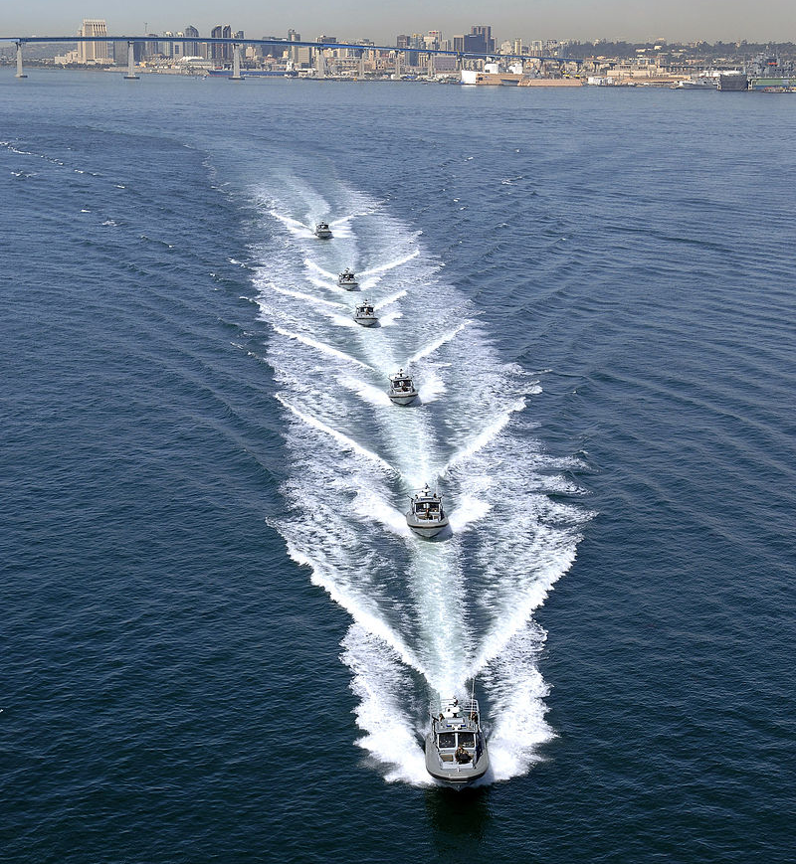

Slide 49
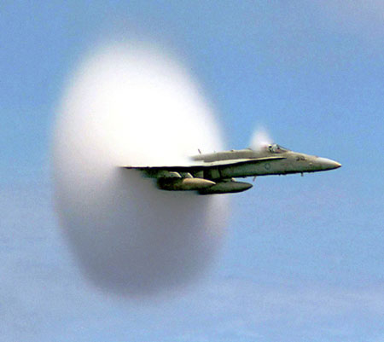

Slide 50
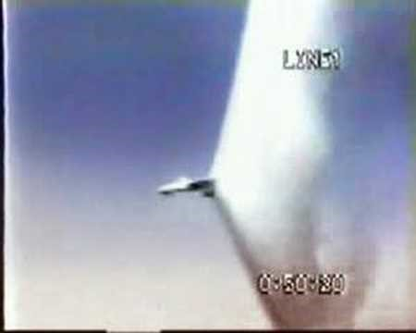

Slide 51
Top: Normal 'dark' spectral line positions at rest. Middle: Source moving away from observer. Bottom: Source moving towards observer. (Public domain image courtesy NASA: http://www.jwst.nasa.gov/education/7Page45.pdf)

Slide 52
High Redshift Galaxy Cluster shown here in false color from the Spitzer Space Telescope. (Public domain image courtesy NASA/JPL-Caltech/S.A. Stanford (UC Davis/LLNL)

